Slide 1
Access Control Course Code: 20B12CS332

Slide 2
Contents of Module 5
Access Policies
Implementing Access Control
Procedure Oriented Access Control
Role Based Access Control
Captchas

Slide 3
Access Control
ACCESS CONTROL: Limiting who can access what in what way
Subjects
Human users, often represented by surrogate programs running on behalf of the users
Objects
Things on which an action can be performed.
Files, tables, programs, memory objects, hardware devices, strings, data fields, network connections, and processors
Access Modes
any controllable actions of subjects on objects, including, but not limited to, read, write, modify, delete, execute, create, destroy, copy, export, import, and so forth.

Slide 4
Access Policies
Decision of access control is based on a access policy.
Access policy simplifies establishing control rules because it reflects the existing policy.
Access control decisions should not be made suddendly
Before implementing access control, an organization needs to take the time to develop a higher-level security policy, which will then drive all the access control rules.

Slide 5
Effective Policy Implementation
Check Every Access
if we detect a user being impersonated. For this reason, we should aim to check every access by a user to an object.
Enforce Least Privilege
a subject should have access to the smallest number of objects necessary to perform some task.
Verify acceptable usage
Ability to access is a yes-or-no decision
checking that the activity to be performed on an object is appropriate.

Slide 6
Tracking
Implementing an appropriate policy is not the end of access administration.
Sometimes administrators need to revisit the access policy to determine whether it is working as it should.
Has someone been around for a long time and so has acquired a large number of no-longer-needed rights?
Do so many users have access to one object that it no longer needs to be controlled?
Administrators need to determine whether the policy and implementation are doing what they should.

Slide 7
Granularity
Granularity we mean the fineness or specificity of access control.
At the other extreme you simply say Adam has complete access to computer C1. That approach may work if the computer is for Adam’s use alone.
if computer C1 is shared, then the system has no basis to control or orchestrate that sharing. Thus, a reasonable midpoint must apply.
Typically a file, a program, or a data space is the smallest unit to which access is controlled.
The finer the granularity, the larger number of access control decisions that must be made, so there is a performance penalty.

Slide 8
Access Log
After making an access decision, the system acts to allow that access and leaves the user and the object to complete the job.
Systems also record which accesses have been permitted, creating what is called an audit log.
It is created and maintained by the system, and it is preserved for later analysis.
Granularity matters in access log
Recording each memory byte access is too lengthy
Recording login into system and log out may contain only limited detail.

Slide 9
Reasons for Access Logging
Records of accesses can help plan for new or upgraded equipment, by showing which items have had heavy use.
If the system fails, these records can show what accesses were in progress and perhaps help identify the cause of failure.
If a user misuses objects, the access log shows exactly which objects the user did access.
In the event of an external compromise, the audit log may help identify how the assailant gained access and which data items were accessed (and therefore revealed or compromised). These data for after-the-fact forensic analysis have been extremely helpful in handling major incidents.

Slide 10
Limited Privilege
Act of restraining users and processes so that any harm they can do is not catastrophic.
A system that prohibits all accesses to anything by anyone certainly achieves both confidentiality and integrity, but it completely fails availability and usefulness.
we seek a midpoint that balances the need for some access against the risk of harmful, inappropriate access.
we want to limit exposure from misbehaving users or malfunctioning processes
The process of analyzing users and determining the privileges they require is a necessary first step to authorizing within those limits.
After establishing the limits, we turn to access control technology to enforce those limits.

Slide 11
Implementing Access Control
Reference Monitor
Access Control Directory
Access Control Matrix
Access Control List
Privilege List
Capability List

Slide 12
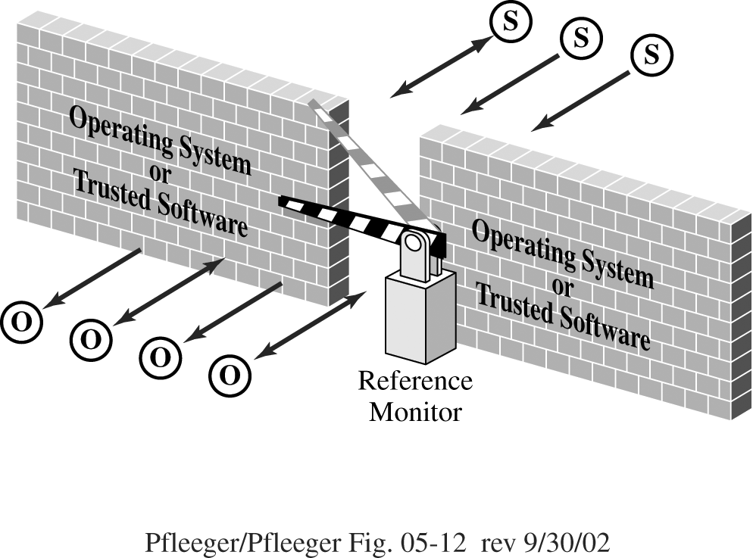
Reference Monitor

Slide 13
Reference Monitor
access control that is always invoked, tamperproof, and verifiable.
A reference monitor is a notion, not a tool you can buy to plug into a port.
It could be embedded in an application (to control the application’s objects), part of the operating system (for system-managed objects) or part of an appliance.
To have an effective reference monitor, we need to consider effective and efficient means to translate policies, the basis for validation, into action.

Slide 14
Access Control Directory
O: Owner, R: Read, W: Write, X: Execute

Slide 15
Access Control Directory Issues
List becomes too large if many users share objects
Revocation of access
Propagation of access rights
Pseudonyms
Two distinct sets of access rights

Slide 16
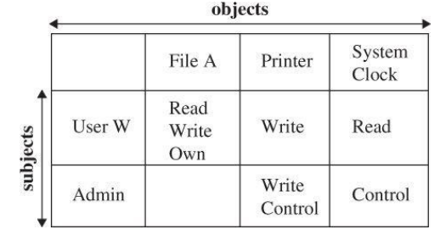
Access Control Matrix

Slide 17
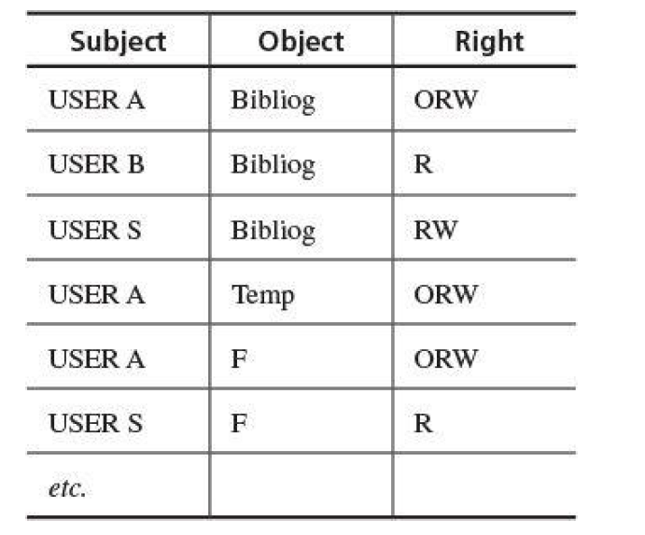
Access Control Matrix
O: Owner, R: Read, W: Write, X: Execute

Slide 18
Access Control List
Split the Access control matrix into its columns and store each column with its corresponding object.
These columns are known as access control lists, or ACLs.
Whenever an object is accessed, its column of the access control matrix could be consulted to see whether the operation is allowed.
For example, the ACL corresponding to insurance data in is
(Bob, —), (Alice, rw), (Sam, rw), (Accounting program, rw).

Slide 19
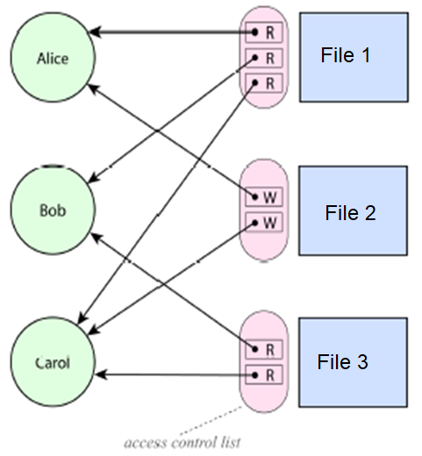
Access Control List Diagram

Slide 20
Access Control List Diagram

Slide 21
Privilege List
A privilege list, sometimes called a directory
It is a row of the access matrix, showing all those privileges or access rights for a given subject.
Advantage of a privilege list is ease of revocation
If a user is removed from the system, the privilege list shows all objects to which the user has access so that those rights can be removed from the object.

Slide 22
Capability List
Alternatively, we could store the access control matrix by row, where each row is stored with its corresponding subject.
Whenever a subject tries to perform an operation, we can consult its row of the access control matrix to see if the operation is allowed.
This approach is know as capabilities, or C-lists.
For example, Alice’s C-list is (OS, rx), (accounting program, rx), (accounting data, r), (insurance data, rw), (payroll data, rw).

Slide 23
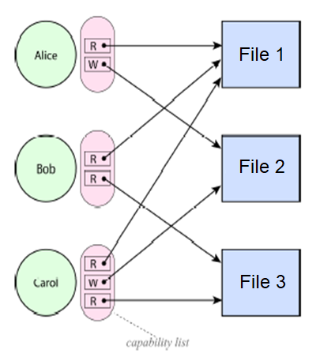
Capability List Diagram

Slide 24
Capability List Diagram

Slide 25
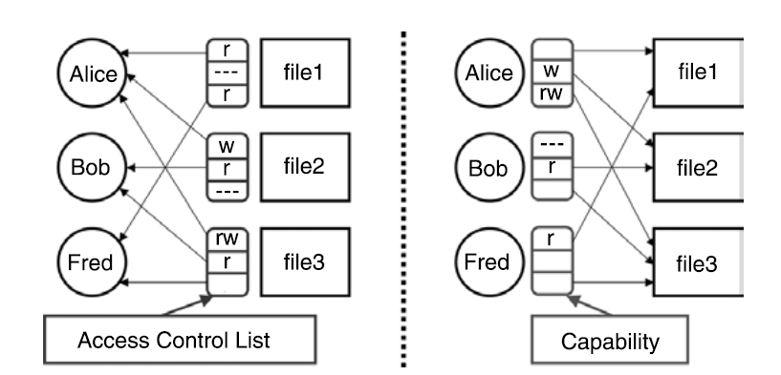
Difference between ACL and C- List

Slide 26
Procedure Oriented Access Control
One goal of access control is restricting not just what subjects have access to an object, but also what they can do to that object.
By procedure-oriented protection, we imply the existence of a procedure that controls access to objects.
for example, by performing its own user authentication to strengthen the basic protection provided by the basic operating system
In essence, the procedure forms a capsule around the object, permitting only certain specified accesses.

Slide 27
Procedure Oriented Access Control
Procedures can ensure that accesses to an object be made through a trusted interface.
For example, neither users nor general operating system routines might be allowed direct access to the table of valid users.
Instead, the only accesses allowed might be through three procedures: one to add a user, one to delete a user, and one to check whether a particular name corresponds to a valid user.
Procedure-oriented protection implements the principle of information hiding because the means of implementing an object are known only to the object’s control procedure
With procedure-oriented protection, there can be no simple, fast access checking, even if the object is frequently used.

Slide 28
Role Based Access Control
Role-based access control lets us associate privileges with groups
Role-based access control can model the separation of duty rule
For example, some users (such as administrators) to have significant privileges, and we want others (such as regular users or guests) to have lower privileges.
Access control keeps up with a person who changes responsibilities, and the system administrator does not have to choose the appropriate access control settings for someone

Slide 29

What is Captchas?
Completely Automated Public Turing test to tell Computers and Humans Apart
Luis von Ahn, Manuel Blum, Nicholas J. Hopper, and John Langford
First to coin the term CAPTCHA in 2000 at CMU when they developed the first CAPTCHA used by Yahoo
The goal:
To create an automated test that is easy for a human to pass but difficult for a computer
Optical character recognition (OCR) is a difficult problem for computers to solve
Take advantage of the fact that humans are good at recognizing patterns that computers have trouble with
The most common form of CAPTCHAs are images of text that are distorted:
www.iup.edu

Slide 30
Some Applications of Captcha
Online Polls
Protect website registration
Prevent comment spam on blogs
Search engine bots
Prevent dictionary attacks
www.iup.edu

Slide 31
Some Applications of Captcha
Online Polls
Protect website registration
Prevent comment spam on blogs
Search engine bots
Prevent dictionary attacks
www.iup.edu

Slide 32
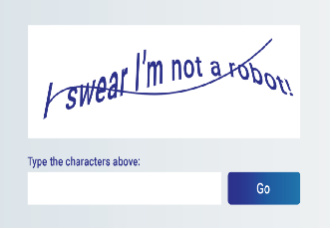
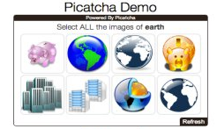
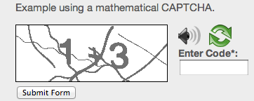

Some examples of Captcha
Distorted text
Picture identification
Simple Math CAPTCHA with Audio
3D CAPTCHA
www.iup.edu

Slide 33
Accessibility Issues
While you want to stop unwanted bots, you don’t want to keep legitimate users out
Visually impaired users will not be able to solve image based CAPTCHAs
Like OCR, speech recognition is also a difficult problem for computers to solve
Person with hearing disability will not be able to pass through it.
www.iup.edu

Slide 34
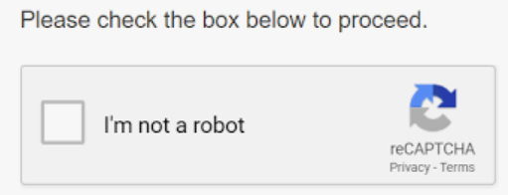
reCaptcha
Developed by Luis von Ahn, Ben Maurer, Colin McMillen, David Abraham, and Manuel Blum at CMU
Acquired by Google in September 2009
Scanned books and text which were not read by OCR were kept in a database for producing while validating human.
Later, It was also compromised with advancement in image processing
Google came with reCaptcha V2
reCAPTCHA v3 verifies requests with a score and gives you the ability to take action in the context of your site.
www.iup.edu

